Slide 1

Alpha Beauty Market Test Results
By Chiugo Ezekwem

Slide 2
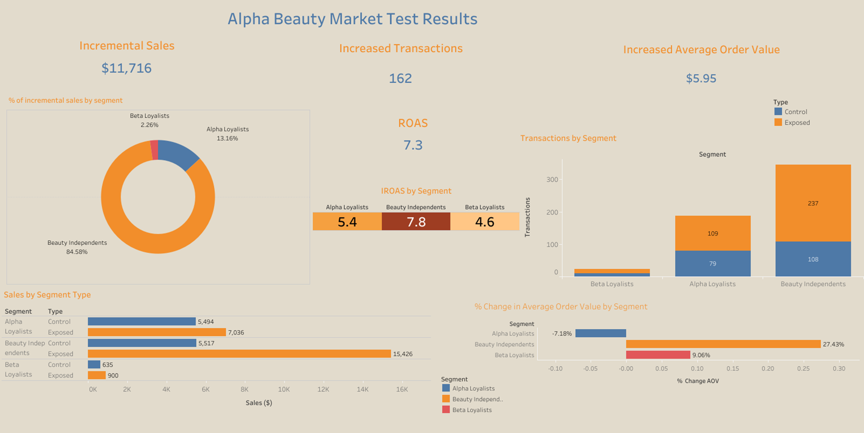

Slide 3
How did each Cohort do?
Cohort Segments
Alpha Loyalists
Beauty Independents
Beta Loyalists
28% increase in Sales
5.4x Incremental ROAS
38% increase in number of transactions
Average Order Value decreased by 7%
180% increase in Sales
7.8x Incremental ROAS (Highest return of the 3 cohorts)
119% increase in transaction volume
Average Order Value increased by 27%
42% increase in Sales
4.6x Incremental ROAS
30% increase in number of transactions
9% increase in average order value

Slide 4
Overall Key Insights
Incremental Sales | $11,716
Transactions | 162
Average Order Value | $5.95
ROAS | 7.3x
Additional Market Test Cost | $1,613.17
Sales increased by 101%
Transactions also increased by 82%
Average order value only had a 10% increase
7.3x ROAS

Slide 5
Did the Test meet our goals?
Goals
1
Customers in exposed groups spent more than those in control groups
√√
2
10x ROAS
√×
3
5x Incremental ROAS for all cohort segments
√×
4
Drive Incremental Sales
√√

Slide 6
Recommendations
Beauty Independents were the best performing cohorts by far and should be focused on
Create targeted campaigns and personalized content based on their product interests & preferences
Increase engagement by offering exclusive access to new product lines, free samples of new products, or any additional benefits that can convert this group to loyalists.
Offer personalized product recommendations based on their purchase history, or exclusive discounts on products they have shown interest in.
Consider keeping the 10% cashback offer since it was so attractive to this cohort and significantly increased sales and transaction volume
For Alpha Loyalists:
Create campaigns that focus on reminding this group of the value of our products, with targeted messaging that showcases the unique benefits of our products.
Targeted offerings like exclusive products, early access to new products and special events & free gifts that show these loyal customers how important they are.
For Beta Loyalists- The weakest performing cohort
Research via sending out surveys to understand what these consumers like about Beta products, investigate what can be incorporated into our products offerings.

